Slide 1
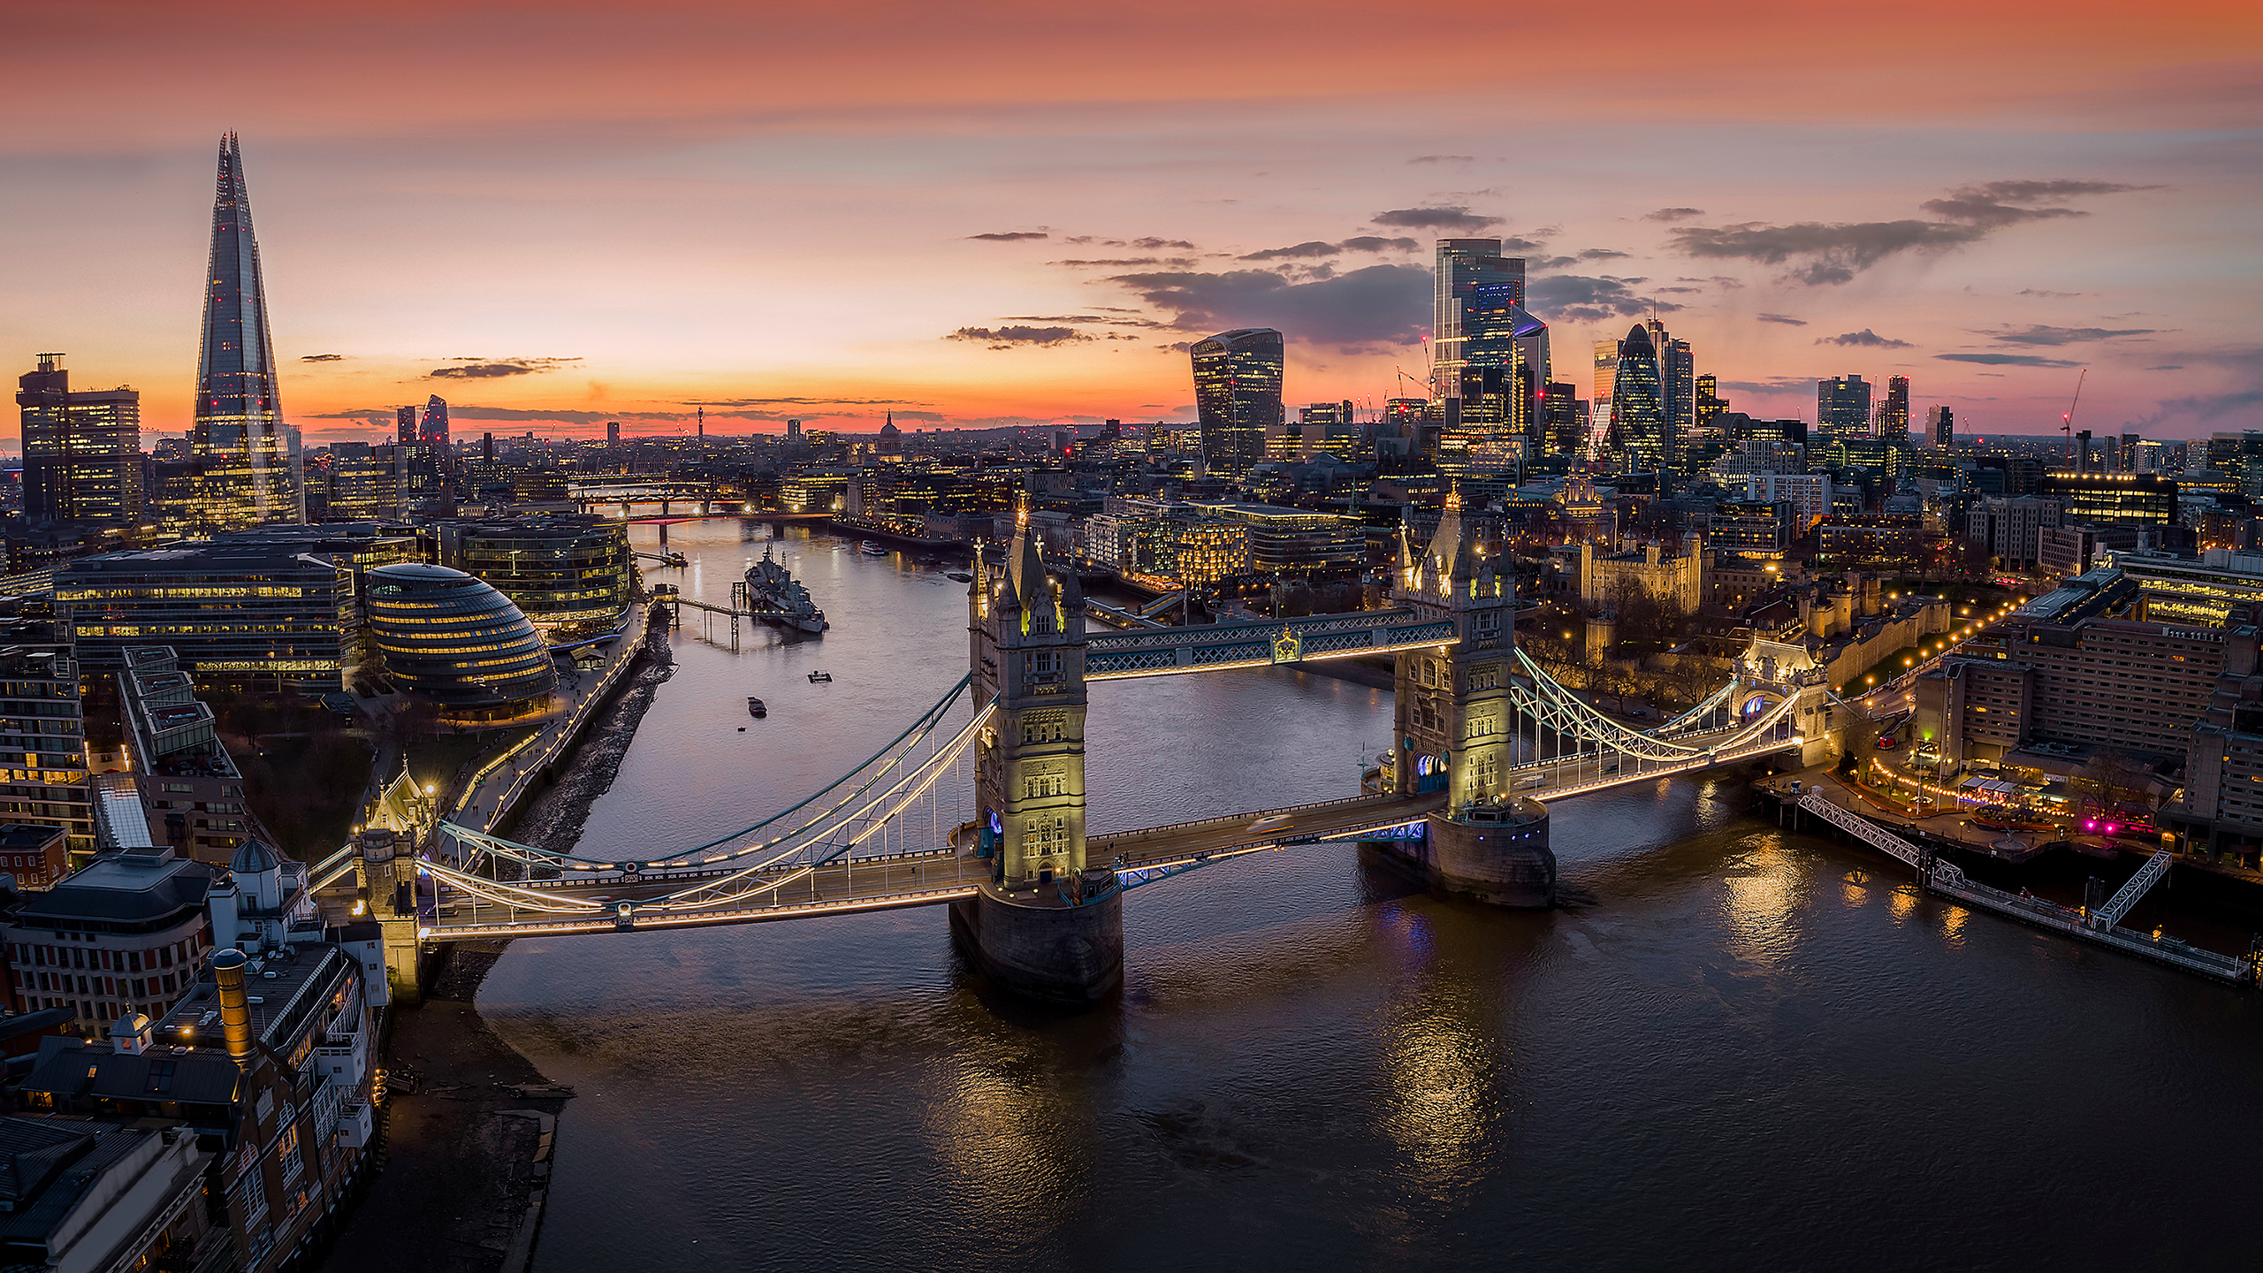
London, UK
WCTC 2023 Hilton Metropole, London Thursday, June 15 – Saturday, June 17, 2023

